Slide 1
SIMPLE TASK MANAGIndividuals can use a simple task manager to keep track of their daily to-do lists, upcoming deadlines, appointments, and other commitments.ER
A simple task manager is a software application designed to help users organize, prioritize, and track tasks or activities. It typically provides a user-friendly interface where users can create, edit, and delete tasks, set deadlines or reminders, and categorize tasks based on different criteria such as priority, status, or project. Individuals can use a simple task manager to keep track of their daily to-do lists, upcoming deadlines, appointments, and other commitments.

Slide 2
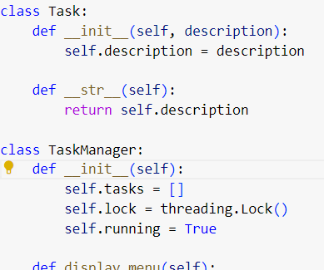

Slide 3
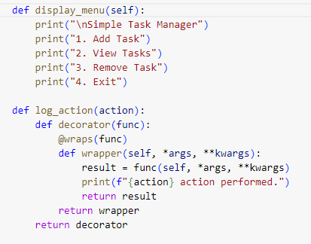

Slide 4
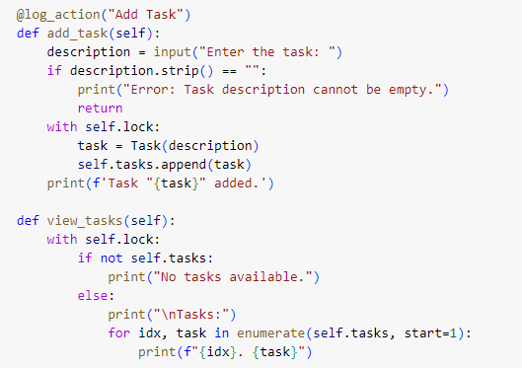

Slide 5
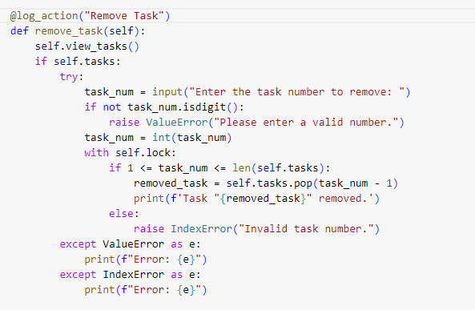

Slide 6
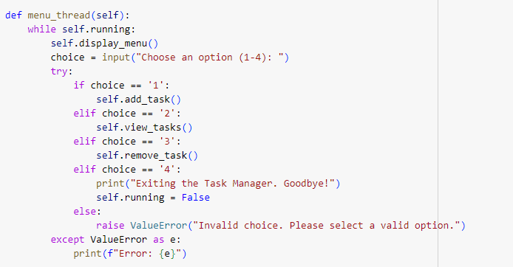

Slide 7
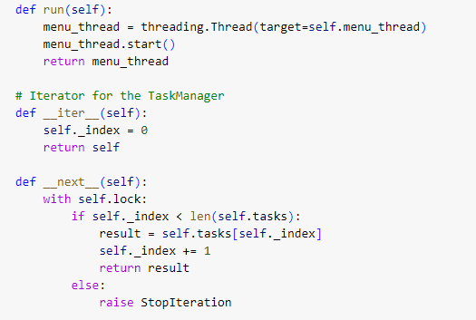

Slide 8
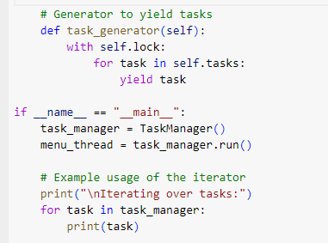

Slide 9
